Slide 1

IMS Administration Tool
ISPF Interface
LAB Exercises
IMS Tools
for z/OS
© 2026 IBM Corporation

Slide 2
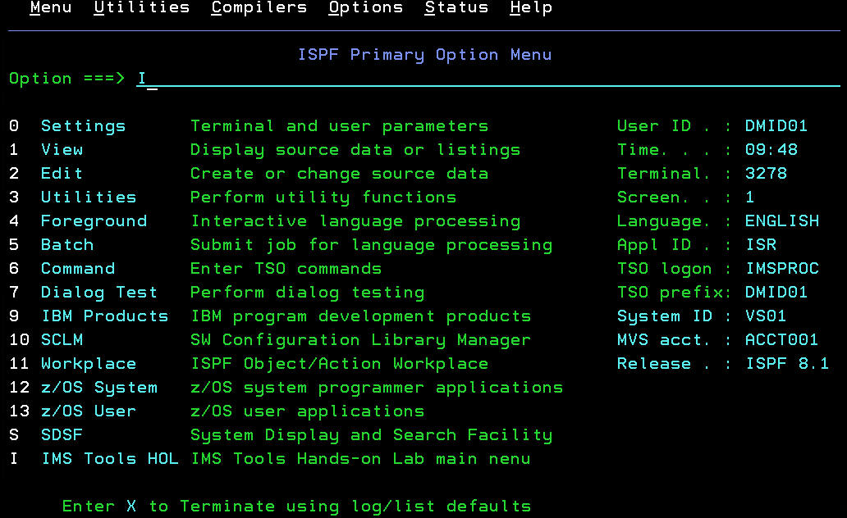
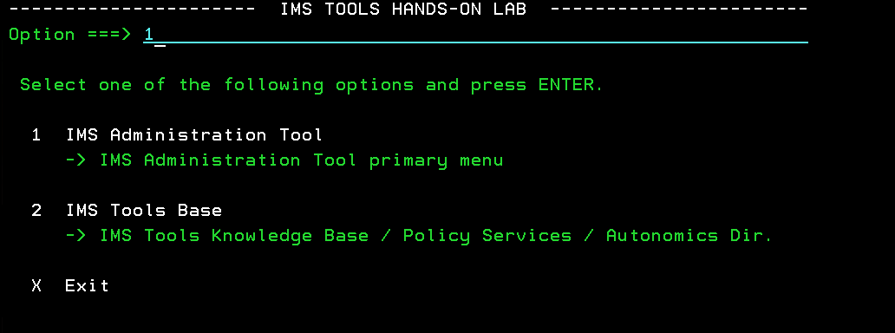
IMS Administration Tool ISPF LAB Exercises
After following the required instructions that your LAB instructor has given you for logging on to the Hands-on LAB system, accessing the main ISPF menu Option “I - IMS Tools HOL”, you will be ready to access the IMS Administration Tool. You must not skip any SETUP and LOGON steps.
You must follow the SETUP instructions that your LAB instructor has given you:
LOGON using a userid DMIDnn (nn = 00 or 01) with case-sensitive password
Specify the procedure IMSPROC and the command ISPF on the LOGON panel
DMID00 is an IMS Tools administrator and DMID01 is an IMS Tools user
Select Option “I” from the ISPF main menu
Select Option IMS Administration Tool main panel
1

Slide 3
IMS Administration Tool
Environment/Tools Configuration
Exercise 1 (optional)

Slide 4
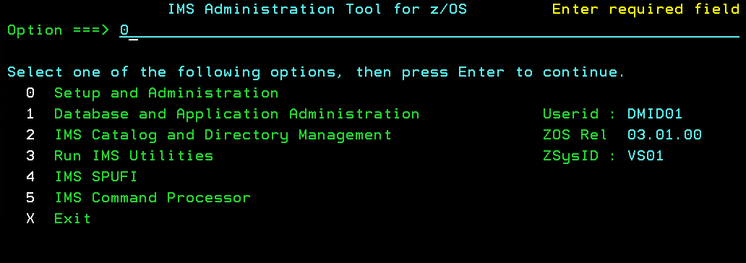
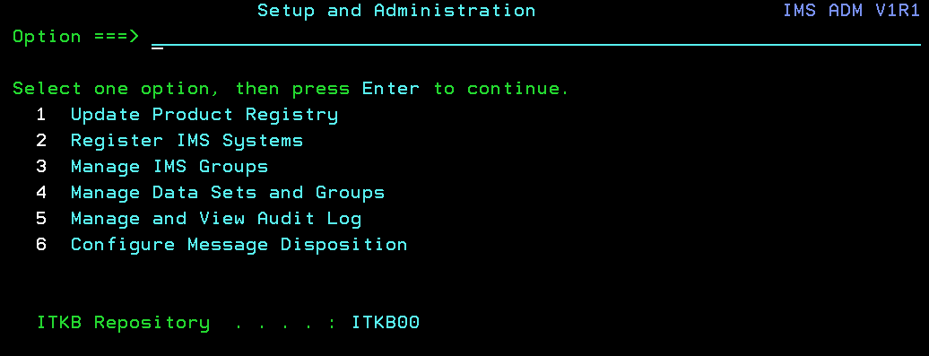
IMS Administration Tool ISPF LAB Exercise 1
Key Feature: Setup and Administration
Description: Allows you to change Global Settings, Update the ITKB IMS Tools Product Registry, Register IMS Systems, Manage IMS Groups, and View the Audit Log.
Instructions: Select Option “0” and press Enter if you want to see what it provides. If you do look at the SETUP and Administration panels, you will need to press PF3 to get back to the primary menu.
Note: Use the userID DMID00 to use Option “0”. User IDs other than DMID00 cannot use Option “0”.
You can bypass this step, if you prefer. Any setup changes could impact the lab exercises.

Slide 5
DBD and PSB Management
(with Resource Updates)
Exercise 2
This exercise is useful if you want to learn how easy it is to decode/make changes to DBD/PSB source from various sources (DBDLIB, PSBLIB, ACBLIB, IMS Catalog directories, etc.) and populate those changes to the IMS Catalog (Staging Directory).
Note: IMS Administration Tool currently populates the changes to the STAGING directory only.

Slide 6
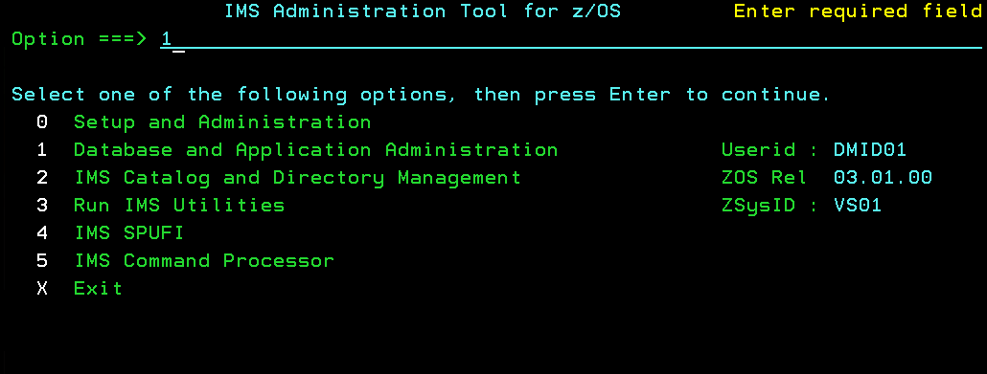
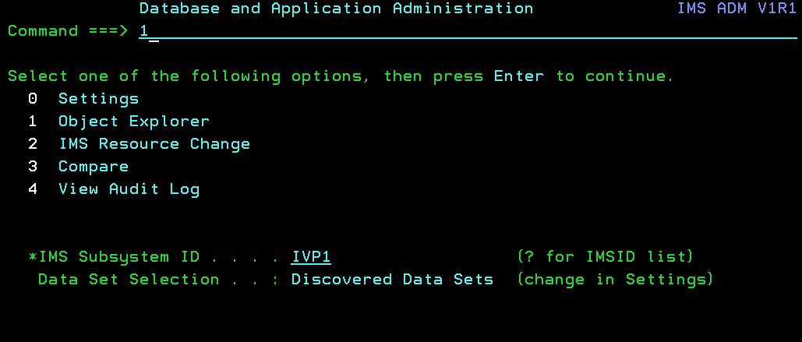
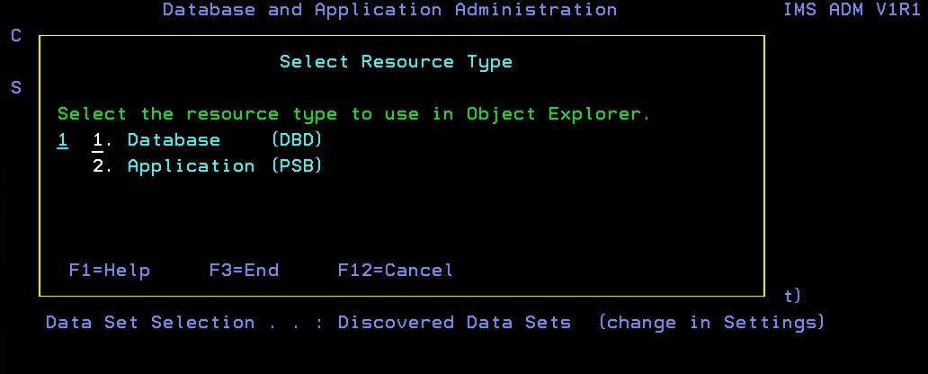
IMS Administration Tool ISPF LAB Exercise 2
Key Feature: Database (DBD) and Application (PSB) Administration
Description: Allows you to decode/make changes to DBD/PSB source from various sources (DBDLIB, PSBLIB, ACBLIB, IMS Catalog directory, etc.) and populate those changes.
Instructions:
Select Option (Database and Application Administration), starting from the arrow.
Select Option (Object Explorer). You should be using the IMS Subsystem ID “IVP1” and discovered data set.
Select for Database (DBD).
1
1
1

Slide 7
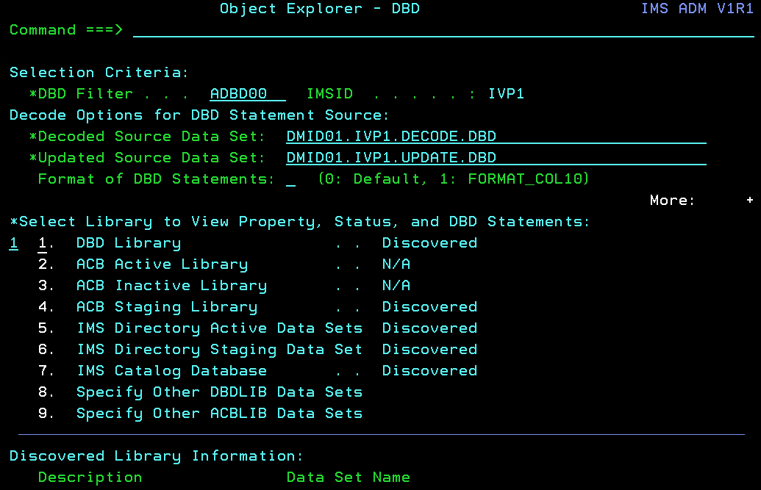
IMS Administration Tool ISPF LAB Exercise 2 (cont’d)
Key Feature: Database (DBD) and Application (PSB) Administration
Description: We will go through an exercise now to show you how to filter on a specific DBD, decode the DBD from the DBD Library, and then make changes to that DBD so you can populate those changes to the “Staging” IMS directory. This feature also supports PSBs but for this exercise, we will focus on DBDs.
Instructions: Fill-in the required fields marked with an “*”, with the values listed below.
Specify the DBD filter: .
Select (From DBD Library) and press Enter.
ADBD00
1

Slide 8
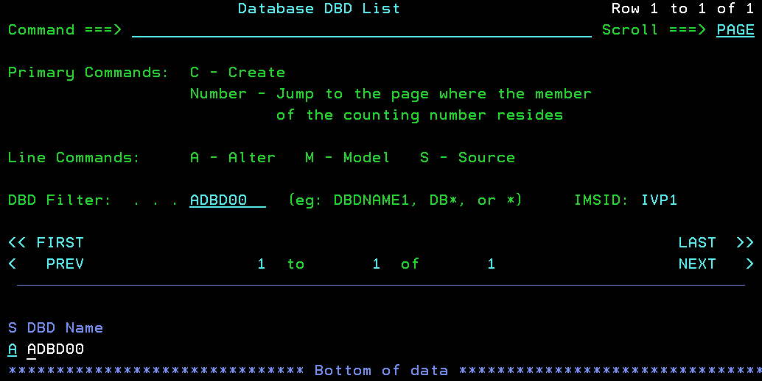
IMS Administration Tool ISPF LAB Exercise 2 (cont’d)
Key Feature: Database (DBD) and Application (PSB) Administration: Altering a DBD
Description: As you can see here, you can either create a new DBD and/or Model from another DBD, decode the DBD to view DBD source, or Alter your existing ADBD00 DBD, which we will be doing in this exercise.
Instructions: Type (Alter) on the line command next to your ADBD00 DBD that you have filtered on, and press Enter.
A

Slide 9
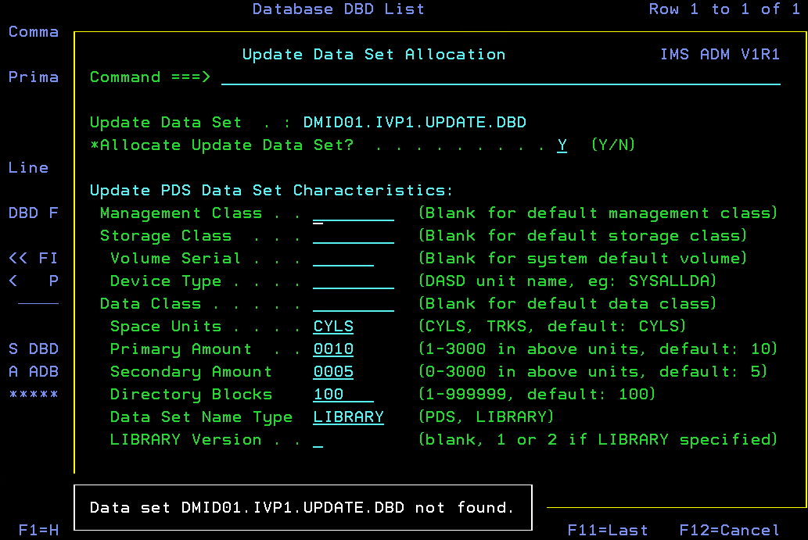
IMS Administration Tool ISPF LAB Exercise 2
Key Feature: Database (DBD) and Application (PSB) Administration
Description: If your ADBD00 datasets which were specified in the previous panel are not yet allocated, you will be prompted to allocate each data set needed. Otherwise, you will be asked if you want to overwrite the data sets and say “Y”.
Instructions: Say “Y”, each time you get prompted for each data set.
Note: You do not need to specify any other allocation parameters.

Slide 10
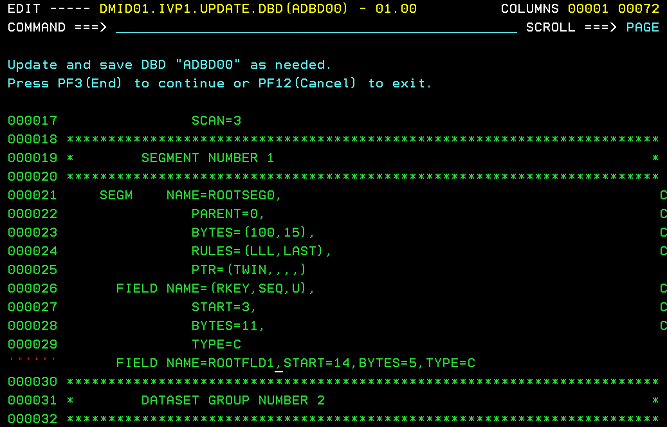
IMS Administration Tool ISPF LAB Exercise 2
Key Feature: Database (DBD) and Application (PSB) Administration
Instructions: Now, let’s Alter your ADBD00 DBD.
Press F8 to scroll down to see the ROOT segment and field definitions.
Insert a new field after the first ROOTKEY field definition statements. The FIELD NAME that is added must be unique. An example field definition: FIELD NAME=ROOTFLD1,START=14,BYTES=5,TYPE=C
Specify “SAVE” on the command line to save the changes to your data set.
Press F3.

Slide 11
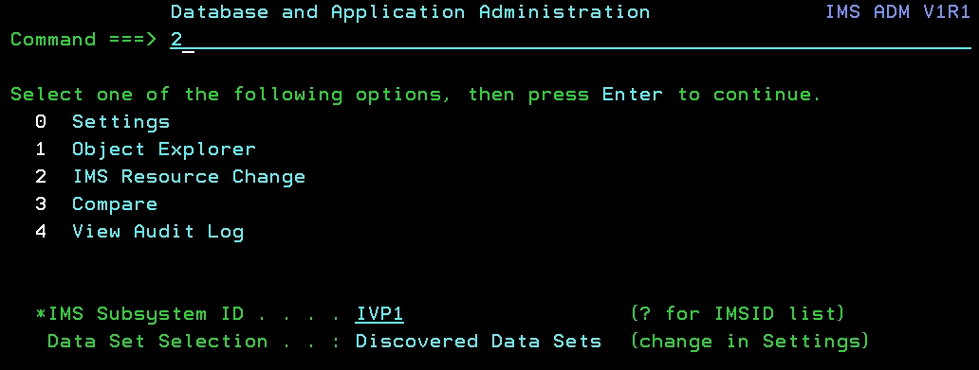
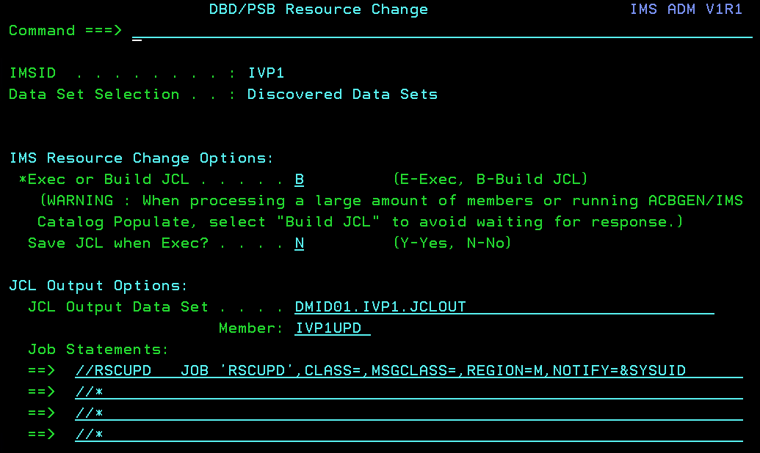
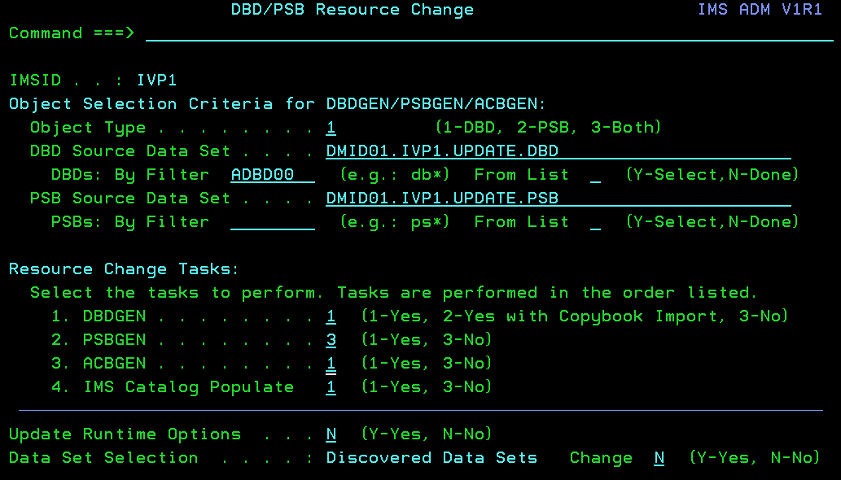
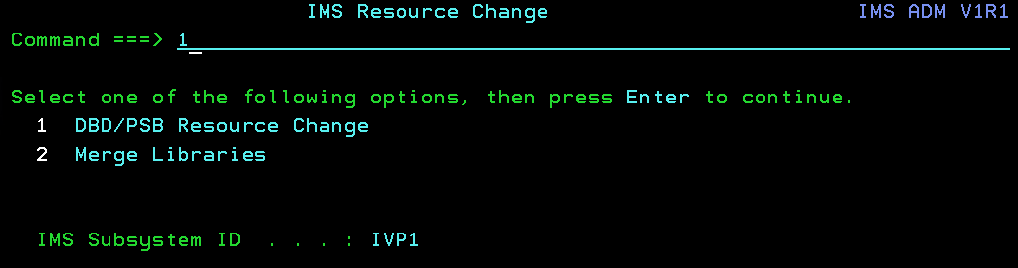
IMS Administration Tool ISPF LAB Exercise 2
Key Feature: Database (DBD) and Application (PSB) Administration: DBD Resource Change
Instructions: After altering the DBD and saving your changes, you will get a message at the bottom of the screen telling you now need to do the resource change to make this effective.
Press PF3 twice to go back to the "Database and Application Administration" menu. You can also do this function under a different panel but we will do it here since the process detects changes and will prompt you to populate the changes that you made to your DBD.
Select "2" IMS Resource Change then press Enter.
Select "1" DBD/PSB Resource Change then press Enter.
Specify "1" for DBD Object Type, and you should have a filter on the ADBD00 database. Also, Specify "1" (YES) to perform a DBDGEN, Specify "3" (NO) to not perform a PSBGEN, and specify "1" (YES) to perform an ACBGEN, and finally specify "1" (YES) to perform the IMS Catalog Populate. Then press Enter.
Specify "B" to build the JCL to do the resource change. Also, provide your DMID01.IVP1.JCLOUT data set name and the jobcard information listed below. The job card needs to be updated with CLASS, MSGCLASS, and REGION values. Press Enter to continue.

Slide 12
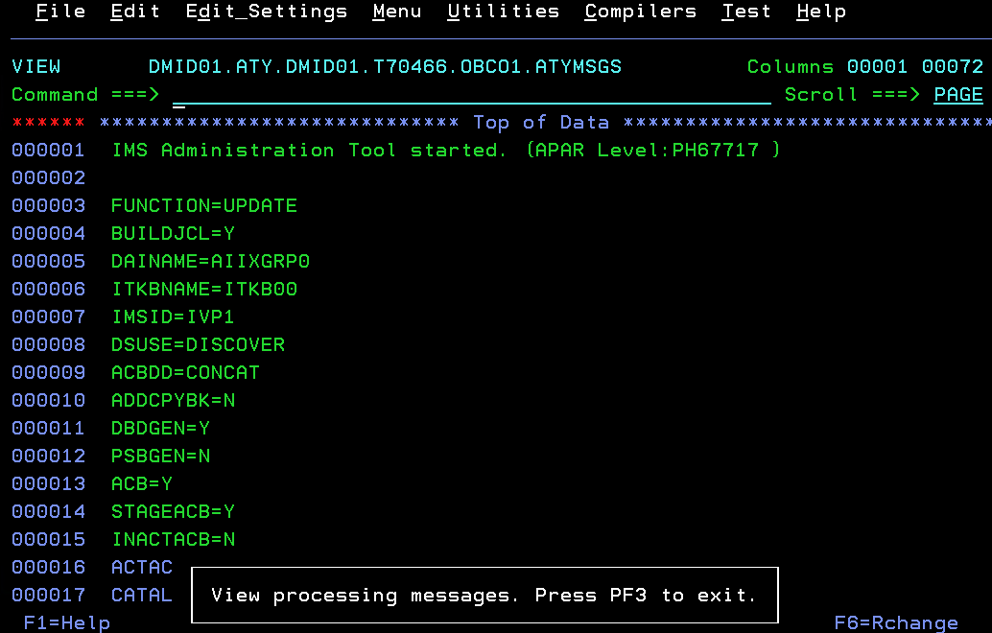
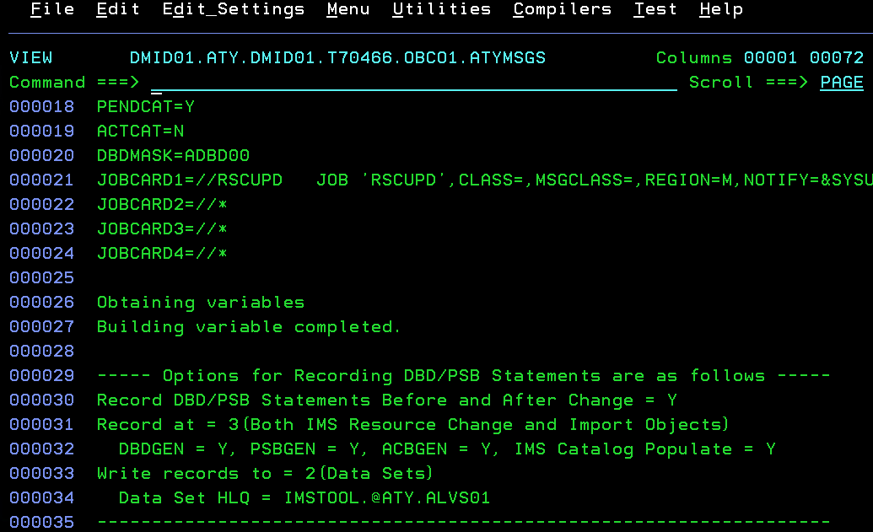
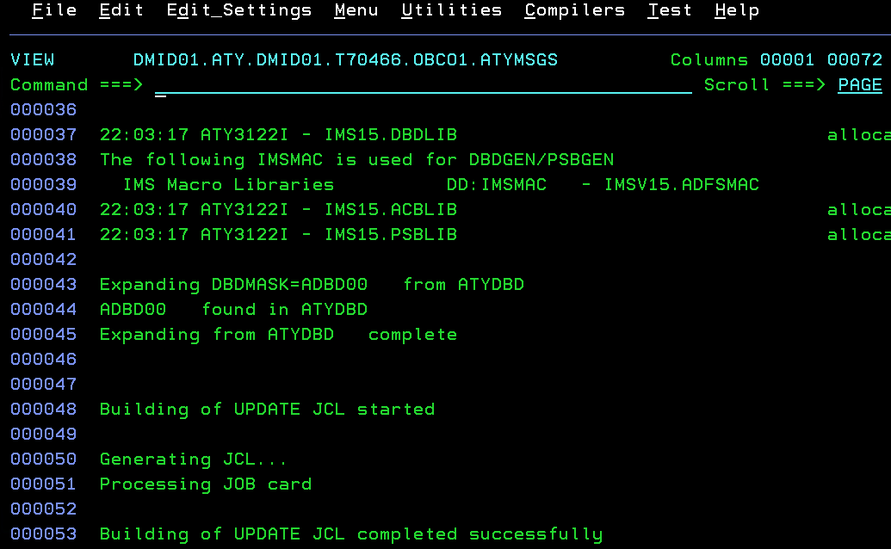
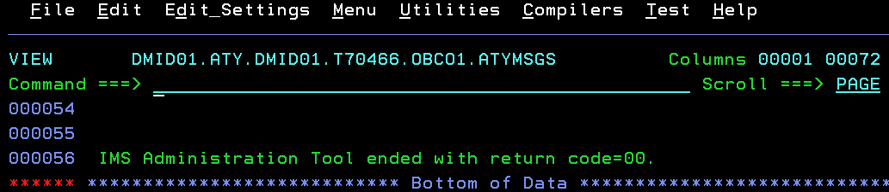
IMS Administration Tool ISPF LAB Exercise 2
Key Feature: DBD Resource Change: View messages/options to be used in JCL Generation
Description: These are the options generated, based on your previous selection, that will be used to generate the JCL. It gives you messages on whether it was successful.
Instructions: Scroll down to see all messages and then press PF3 to see the generated JCL.

Slide 13
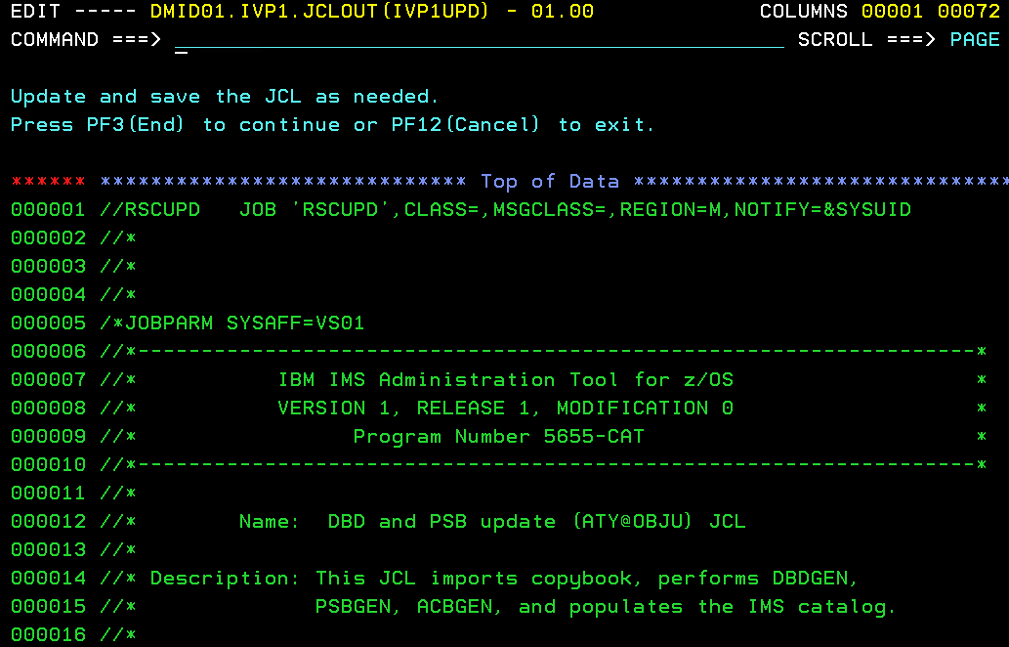
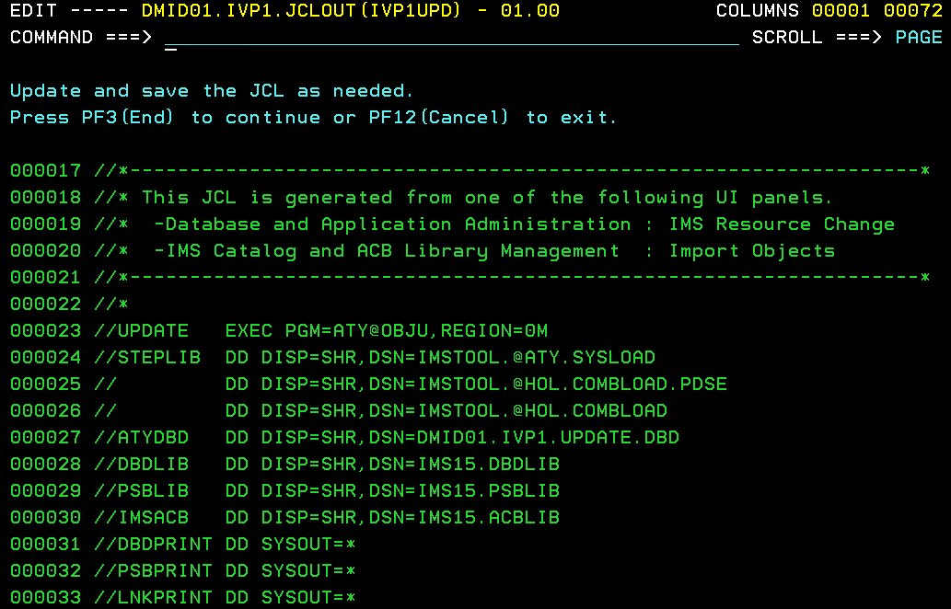
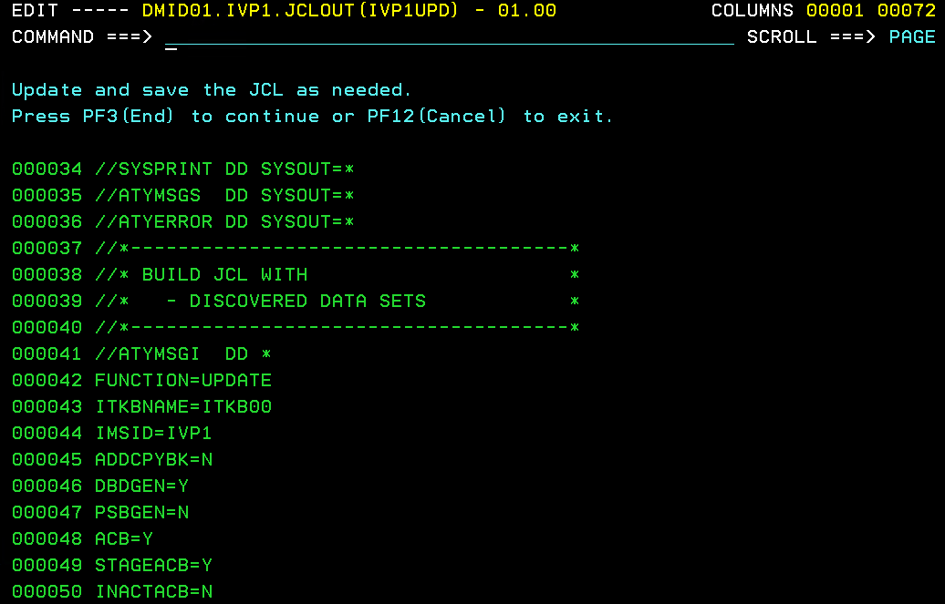
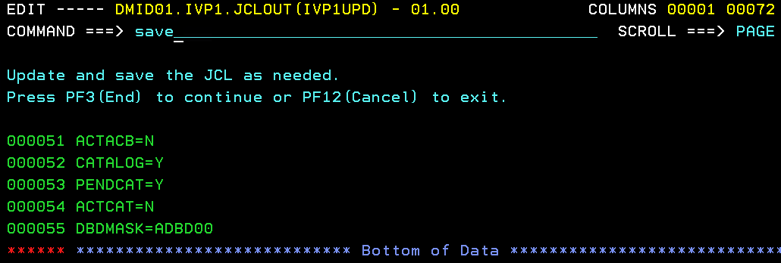
IMS Administration Tool ISPF LAB Exercise 2
Key Feature: DBD Resource Change: Edit and SAVE generated JCL.
Description: You should now see the generated JCL that will contain one simple STEP to do the DBDGEN, ACBGEN, and Resource Change.
Instructions: “SAVE” the JCL (you can optionally scroll down to the see what was generated). Then, press PF3. You will be prompted to Execute the JCL. For the purposes of this exercise, Specify “N” and press Enter.

Slide 14
IMS Administration Tool ISPF LAB Exercise 2
Populating your IMS Catalog “ACTIVE” Directory
Description: Normally after exporting/importing multiple DBD and/or PSB objects, you would then need to manually update the “Active” directory data sets also since IMS Administration Tool will only populate the changes to the “Staging” Directory data sets. In order to populate the active Directory data sets, you would need to either run a SPOC job, issue an IMPORT IMS command, or use IBM IMS High Performance System Generation tool to do this function. The following IMPORT command statement shows parameters that are needed:
IMPORT DEFN NAME(dbdname or psbname) SOURCE(CATALOG)
Instructions: Do not perform the IMS IMPORT command on this system! You have not executed the resource change earlier to the staging libraries (as instructed).
Note: When using the NAME keyword on the IMS IMPORT command to restrict the population to specific objects only vs. populating “every object from the staging” to the active, you must have the following IMSV15 PTF/APAR applied to your IMSV15 RESLIB: APAR PI83433 / PTF UI65332.

Slide 15
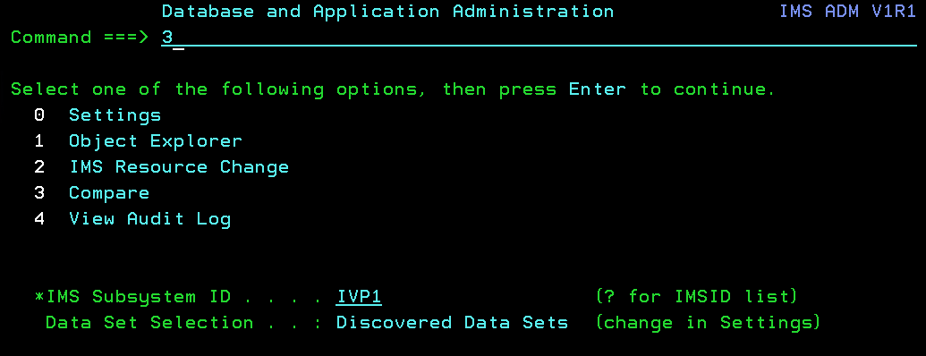
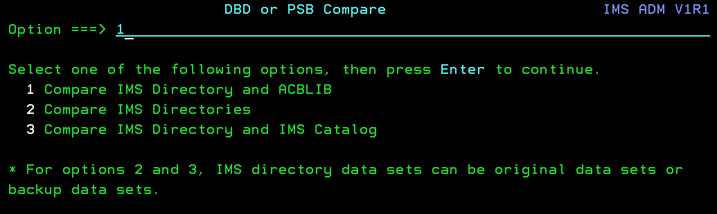
IMS Administration Tool ISPF LAB Exercise 2
Key Feature: Database and Application Administration - Compare
Description: Compare between an IMS Directory data set and an ACBLIB
Instructions: From the “Database and Application Administration” Menu,
Select Option (Compare) and press Enter.
Then, select Option (Compare IMS Directory and ACBLIB) and press Enter.
3
1

Slide 16
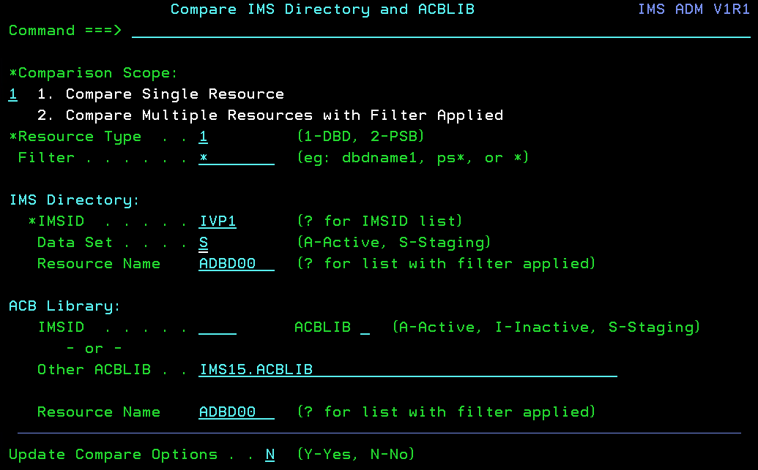
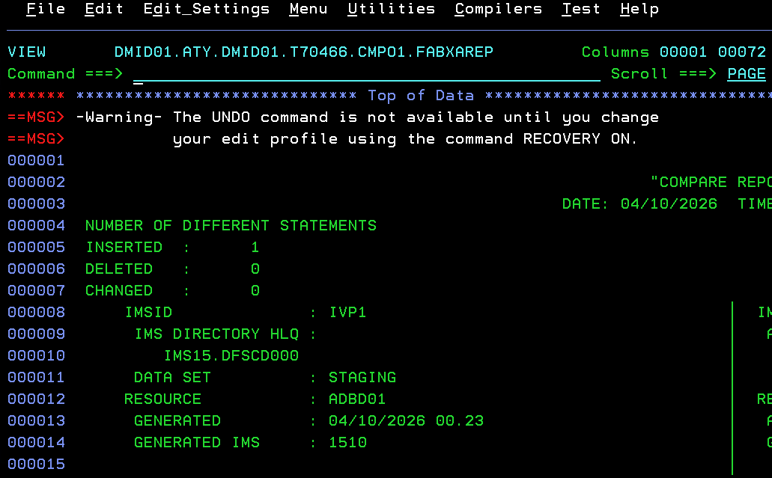
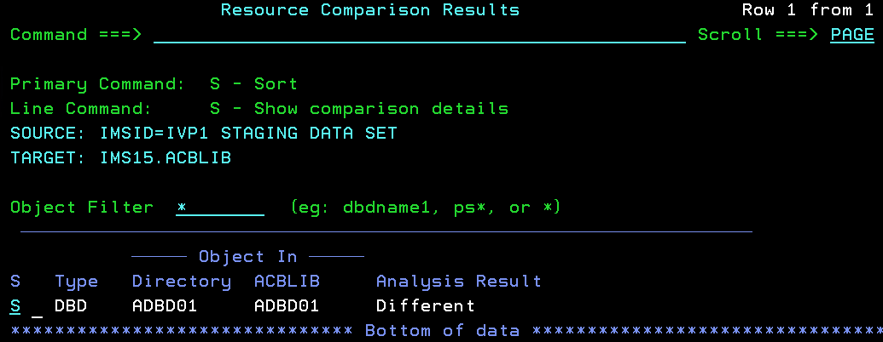
IMS Administration Tool ISPF LAB Exercise 2
Key Feature: Database and Application Administration - Compare
Description: Compare between the IMS Directory data sets of IFA1 (Managed ACBs) and IFA2 (ACBLIB Managed) ACBLIB staging library.
Instructions:
Select Option (Compare Single Resource).
Select Comparison Scope: (Compare Single Resource).
Specify "1" for DBD resource type, IMS Directory IMSID is IVP1, IMS Directory Data Set is "A", and IMS Directory Resource Name is ADBD01 (in this case you will use FF00 versus using your own set of databases since this DBD has changes that will differ from the active directory.
Specify “IMS15.ACBLIB" for Other ACBLIB field with the Resource Name of ADBD01, and Press Enter.
Once you see the ADBD01 database displayed in the list, specify "S" on the line command to see the comparison details. This may take a minute but you should see that there are differences if you used the ADBD01 database. Otherwise, you can see how easy it is to pinpoint differences between objects in source/target libraries and also be able to see what those differences are by looking at the source details.
1
1

Slide 17
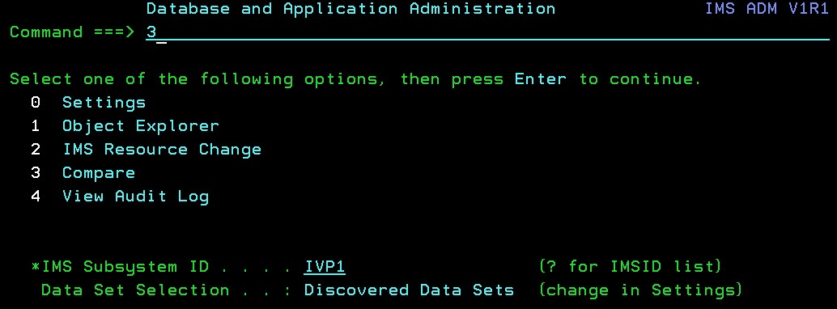
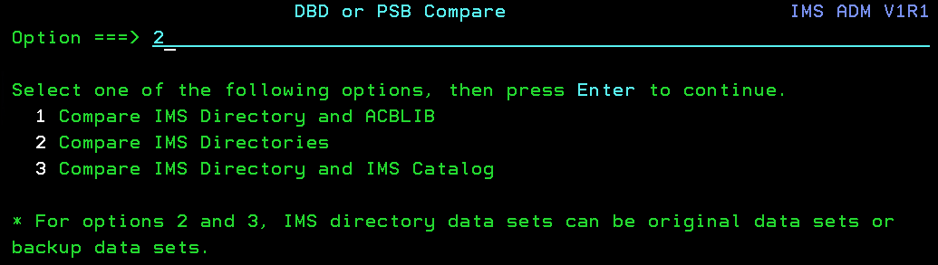
IMS Administration Tool ISPF LAB Exercise 2
Key Feature: Database and Application Administration - Compare
Description: Compare between the IMS Directory data sets
Instructions: If you are interested in seeing other types of compares, you can go back to the “Database and Application Administration” Menu and Select Option (Compare) again and press Enter.
Then, select Option (Compare IMS Directories) and press Enter.
3
2

Slide 18
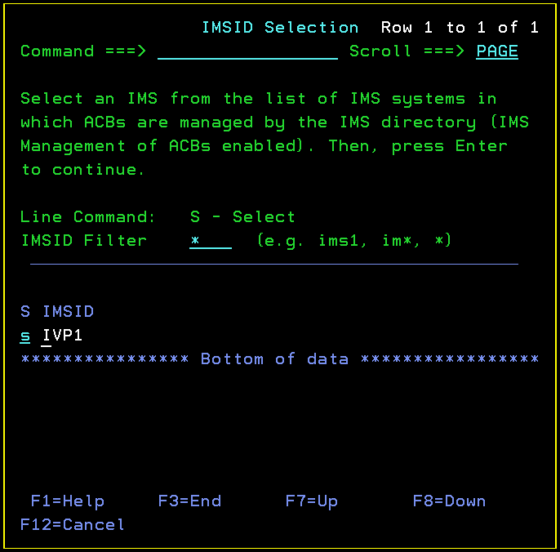
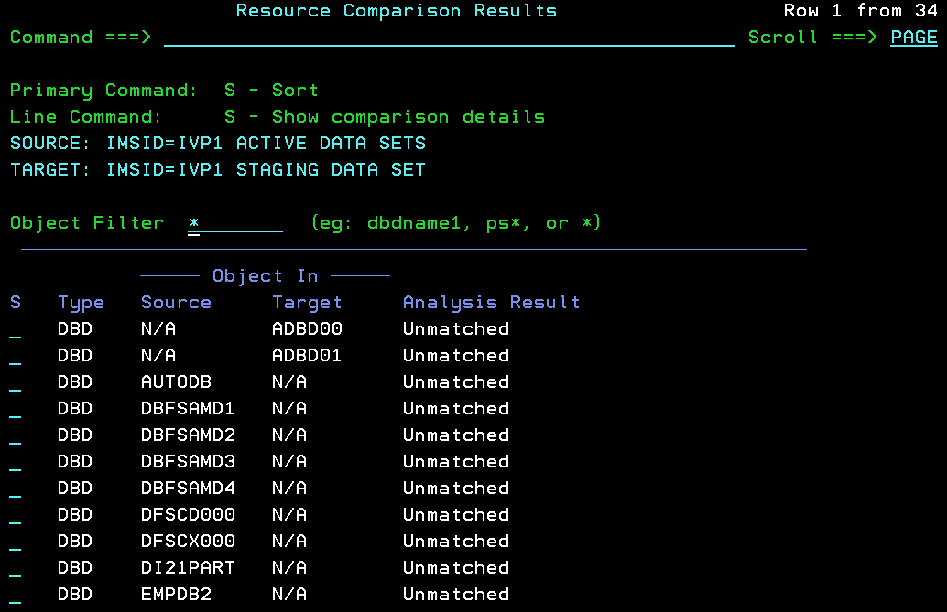
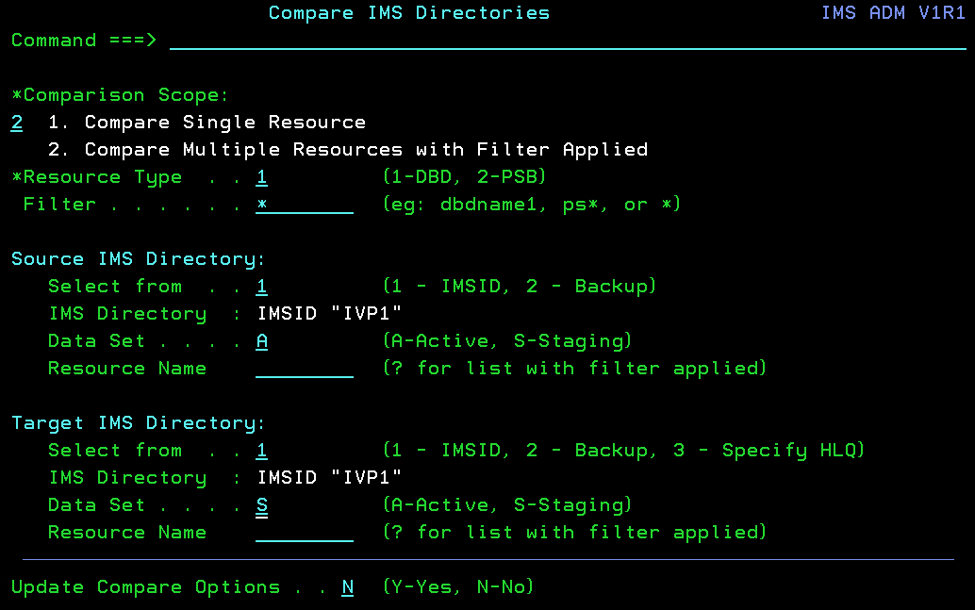
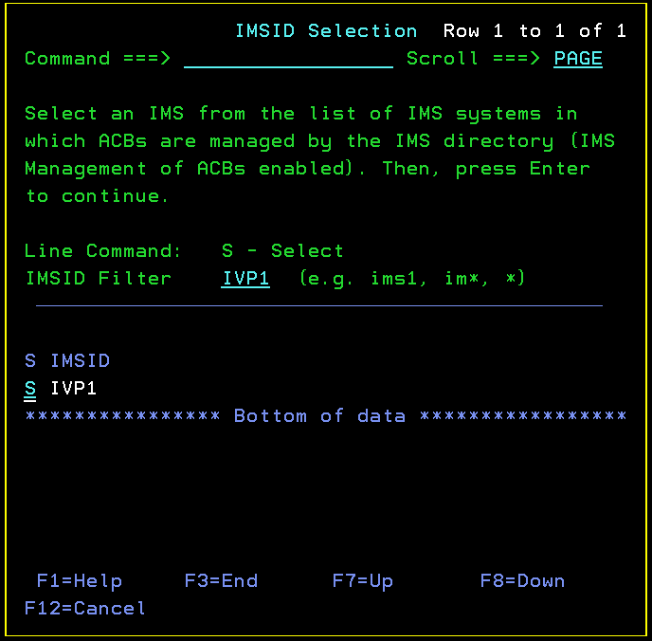
IMS Administration Tool ISPF LAB Exercise 2
Key Feature: Database and Application Administration - Compare
Description: Compare multiple resources between the IMS Directory data sets of IFA1 (Managed ACBs) using filtering.
Instructions:
Select Option (Compare Multiple Resources).
Specify "1" for DBD resource type and specify the Filter "*".
For the Source IMS Directory, specify "1" for IMSID, "A" for the Active IMS Directory, and blanks for the resource name since we are displaying multiple objects using filtering.
For the Target IMS Directory, Specify "1" for IMSID, "S" for the Staging IMS Directory, and blanks for the resource name. Then, press Enter.
You will be prompted with a panel to select the Source IMSID. Select "IVP1", and press Enter. Then, It will bring you back to the previous panel to allow you to select the Target IMSID. Press Enter and you will select "IVP1" from the list. Press Enter.
After both Source and Target IMSIDs are selected, you can press Enter again to see the list of resources that were filtered.
2

Slide 19
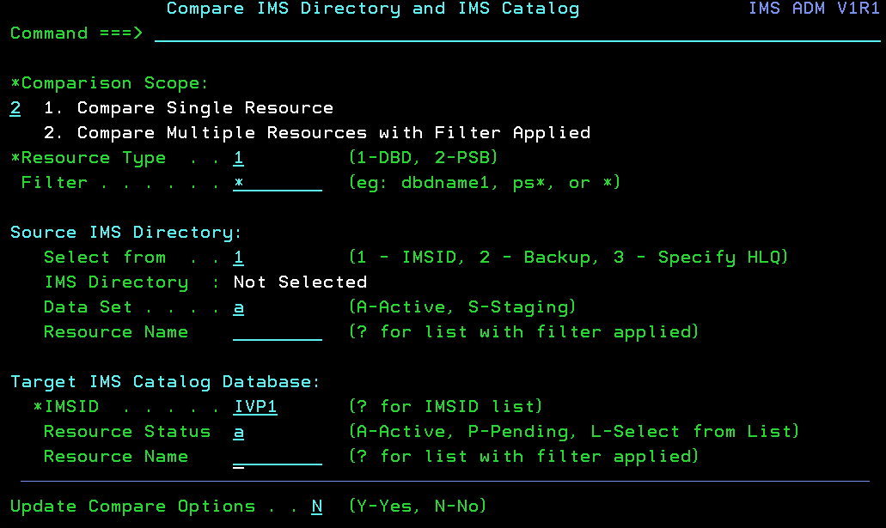
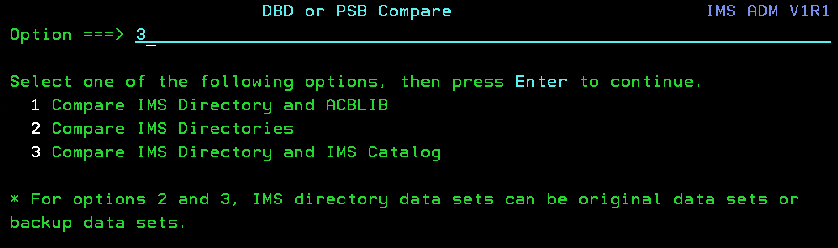
IMS Administration Tool ISPF LAB Exercise 2
Key Feature: Database and Application Administration - Compare
Description: Compare between the IMS Directory and IMS Catalog
Instructions: If you are interested in seeing other types of compares, you can go back to the “Database and Application Administration” Menu, Select Option (Compare) again and Press Enter. Then, select Option (Compare IMS Directory and IMS Catalog) and press Enter.
In this example, we will be comparing all objects that are in the IMS Directory and IMS Catalog to see if both are in sync. Specify the options below that are highlighted in blue, then Press Enter several times to resolve the discovered IMS information and to get a list of objects.
3
3

Slide 20
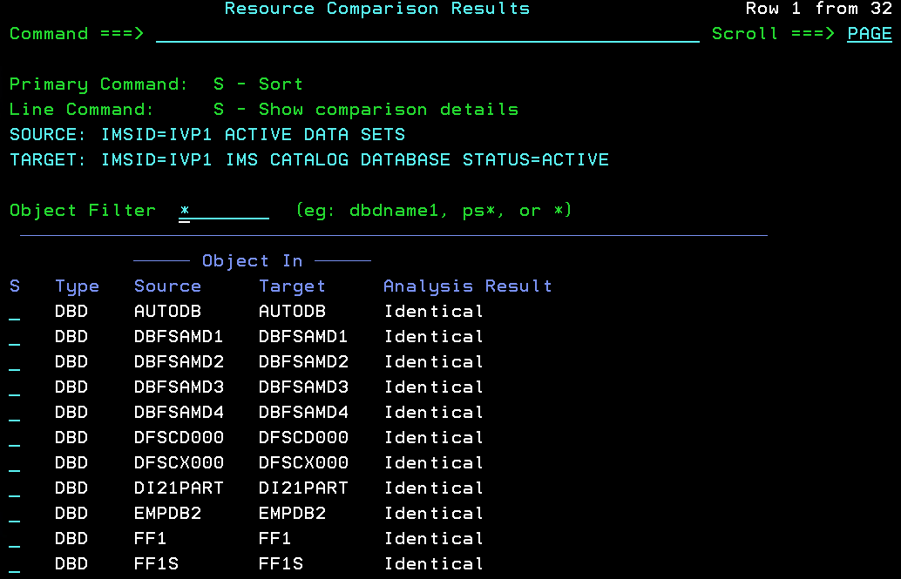
IMS Administration Tool ISPF LAB Exercise 2
Key Feature: Database and Application Administration - Compare
Description: Compare between the IMS Directory and IMS Catalog
Instructions: You should be presented with a list of all objects in both the IMS directory and IMS Catalog. If you scroll down the list, you can see that there are differences. This is helpful when determining which members are out of sync.

Slide 21
IMS CATALOG
AND
DIRECTORY MANAGEMENT
Exercise 3

Slide 22
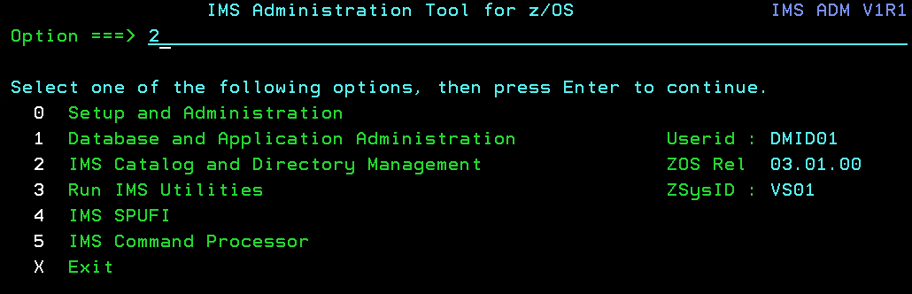
IMS Administration Tool ISPF LAB Exercise 3
Key Feature: IMS Catalog and Directory Management
Description: Helps you manage your IMS Catalog and your ACBLIBs:
Use Catalog space utilization statistics to determine the current state of active and pending catalog libraries for efficient planning and maintenance.
Compare your catalog and ACB libraries to quickly pinpoint discrepancies/differences.
Export and Import DBDs and PSBs.
Backup and Restore Directory/BSDS data sets.
Instructions: Select Option (IMS Catalog and ACBLIB Management), starting with the arrow and press Enter.
2

Slide 23
IMS CATALOG
ANALYSIS and VALIDATION
Exercise 3a

Slide 24
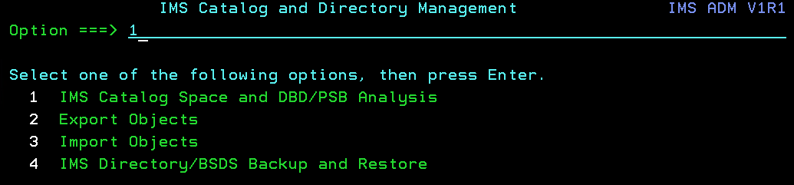
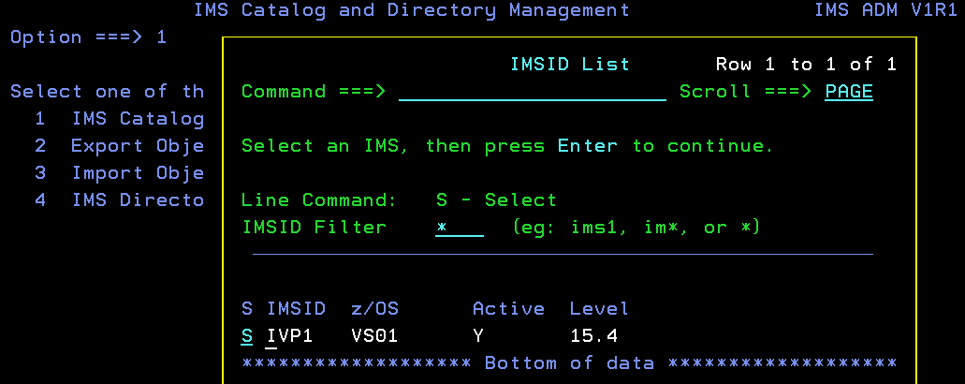
IMS Administration Tool ISPF LAB Exercise 3a
Key Feature: IMS Catalog and Directory Management – IMS Catalog Space and DBD/PSB Analysis
Description: Analyzes your current Catalog state and validates objects within the Catalog and ACBLIB.
Instructions:
Select Option (IMS Catalog Space and DBD/PSB Analysis) and press Enter.
When prompted for an IMS Subsystem ID, specify “IVP1” for the IMSID Filter and Select “IVP1” from the list.
1

Slide 25
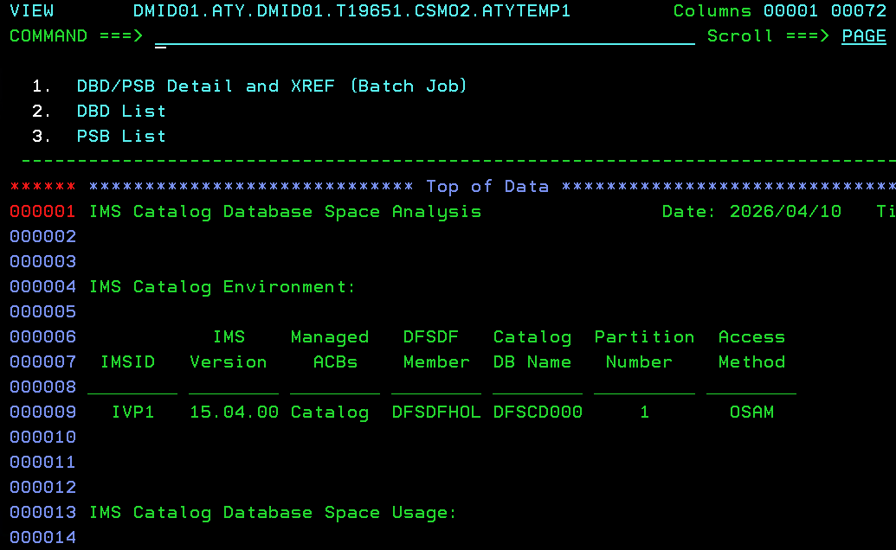
IMS Administration Tool ISPF LAB Exercise 3a
Key Feature: IMS Catalog Database Space Analysis
Description: Since the IMS Catalog Database is a HALDB, it must be maintained just like any other IMS Database. The summary report helps you determine if there is adequate space allocated/remaining for the database.
Instructions: As you can see here, a summary report of your IMS Catalog is presented for your viewing. Scroll up/down (F7/F8) and also to the right/left (F10/F11) to see the entire report.

Slide 26
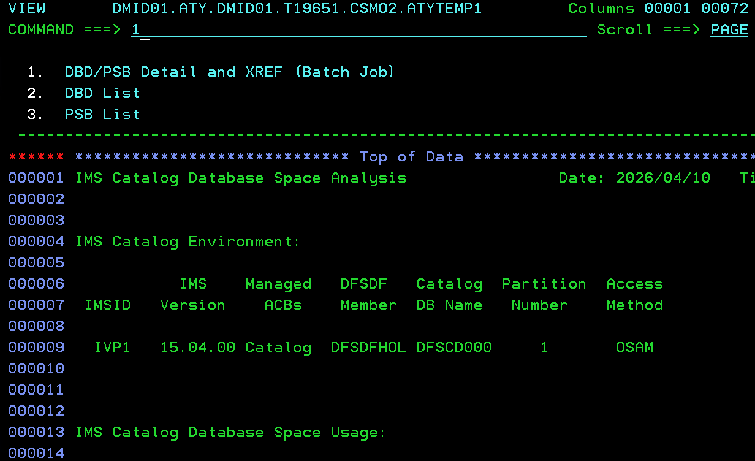
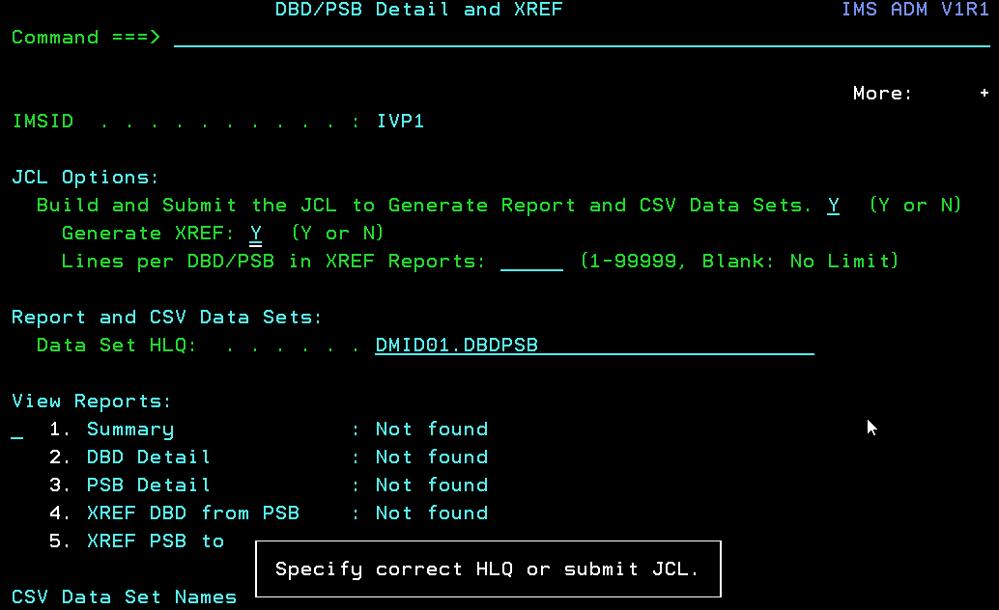
IMS Administration Tool ISPF LAB Exercise 3a
Key Feature: IMS Catalog Database Space Analysis
Description: View DBD and PSB Detail and XREF (using a batch job output)
Instructions: After previously viewing the IMS Catalog Database Space Analysis Report,
Select Option (DBD/PSB Detail and XREF (Batch Job)) and press Enter.
On the next panel, specify “Y” for the first question and specify a data set HLQ if it is not filled in.
Then, press Enter.
1

Slide 27
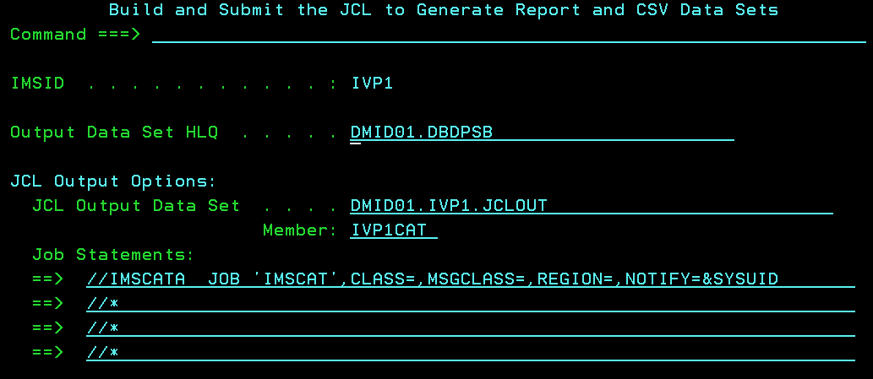
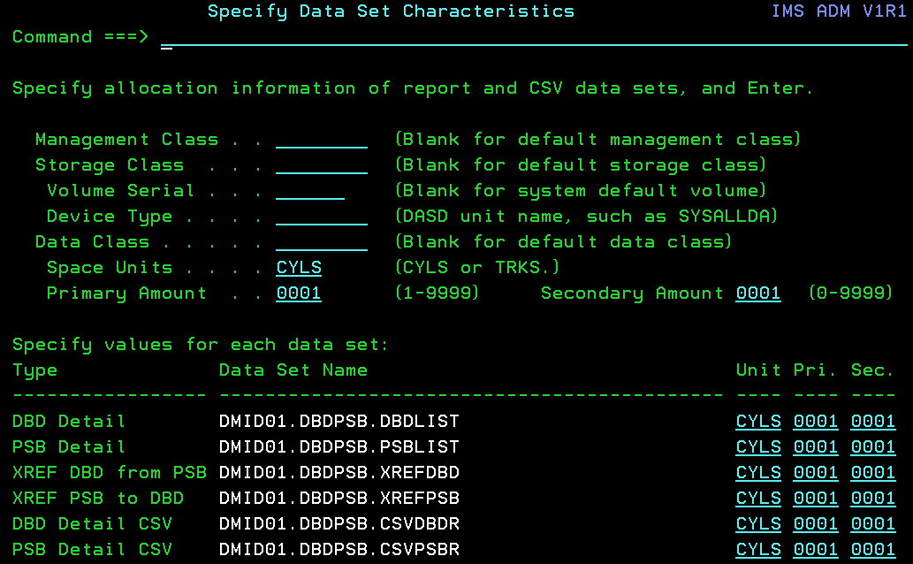
IMS Administration Tool ISPF LAB Exercise 3a
Key Feature: IMS Catalog Database Space Analysis
Description: View DBD and PSB Detail and XREF – Batch job JCL generation
Instructions: On the “Build and Submit the JCL to Generate Report and CSV Data Sets” panel,
Specify CLASS, MSGCLASS, and REGION values, if any is missing, and press Enter key
Then, on the next panel, specify the primary and secondary allocation amount of “0001” and hit Enter key twice.
The next Enter key shows the JCL generation Editor panel on the next page.

Slide 28
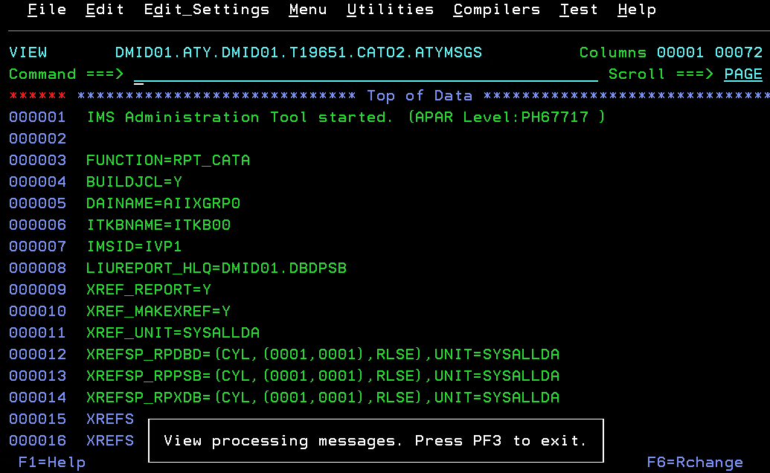
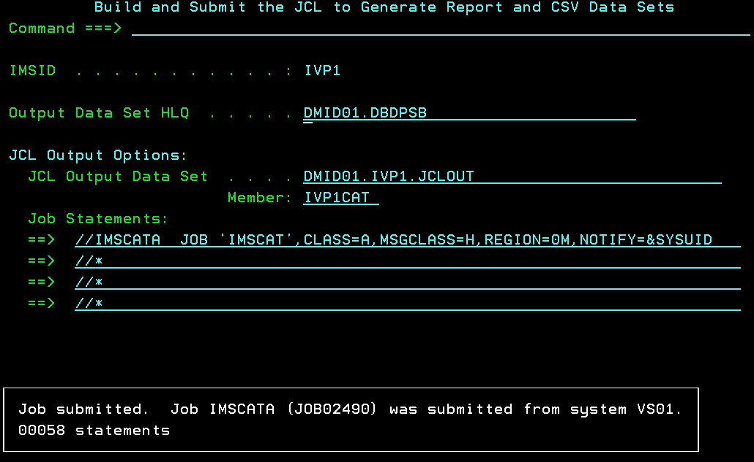
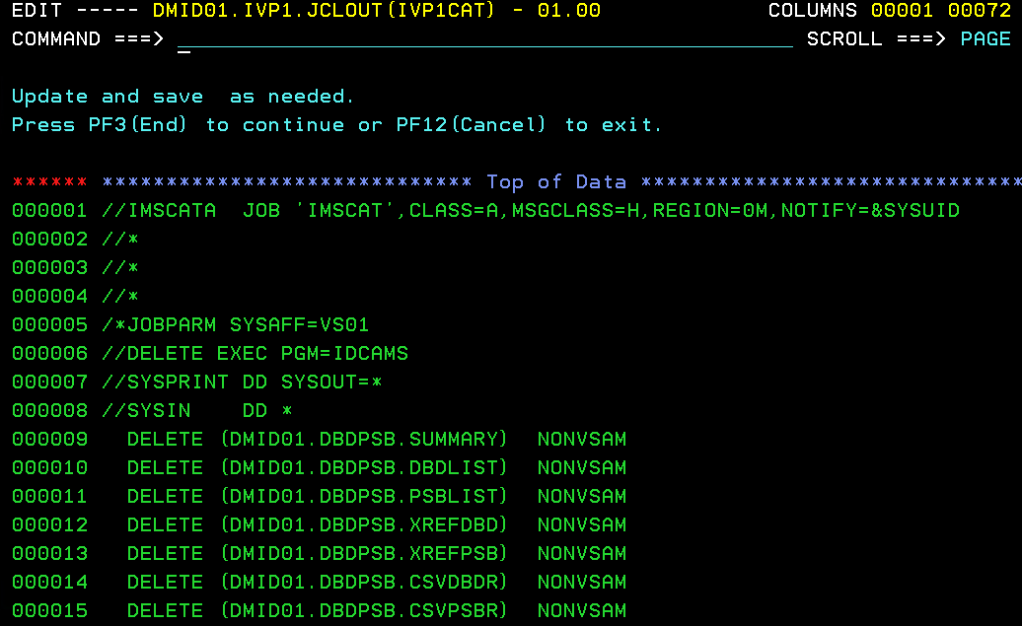
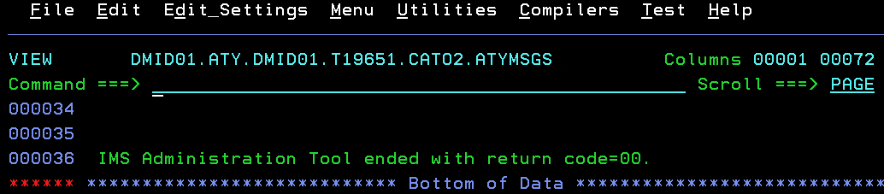
IMS Administration Tool ISPF LAB Exercise 3a
Key Feature: IMS Catalog Database Space Analysis
Description: View DBD and PSB Detail and XREF – Batch job JCL generation (cont.)
Instructions:
Scroll the page to see the processing result and confirm that the JCL generation ended with a return code of 0.
Pressing PF3 (End) shows the generated JCL. Scroll down the page to see the JCL content and press PF3.
You will be asked whether to submit the JCL. Change the answer from ‘N’ to ‘Y’. Then, the JCL will be submitted.
Press PF3 twice to go back to the “DBD/PSB Detail and XREF” panel.

Slide 29
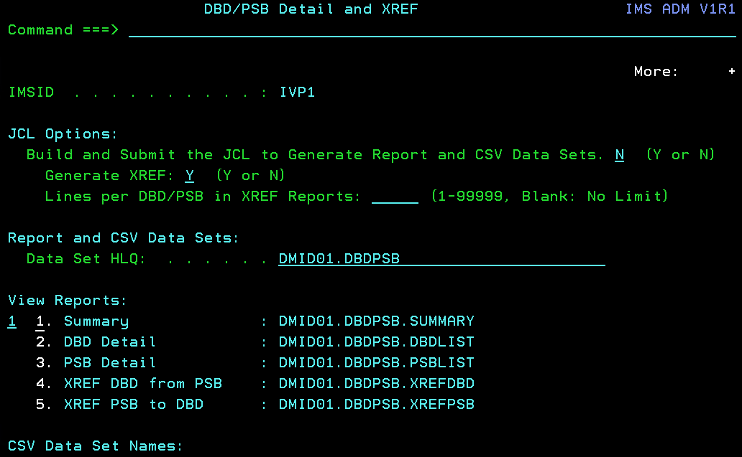

IMS Administration Tool ISPF LAB Exercise 3a
Key Feature: IMS Catalog Database Space Analysis
Description: View DBD and PSB Detail and XREF – DBD/PSB Summary Report
Instructions:
Once you have received a job completion notification, check that the completion code is 0.
Then, change the first option to “N” and select View Report option (Summary), and press Enter.
Then, you see a high level information of DBDs and PSBs. Scroll up/down (F7/F8) and also to the right/left (F10/F11) to see the entire report. You see sections (1) All DBD and PSB Instances, (2) Obsolete DBD Instances, (3) DBDs not pointed to by PSB, (4) PSB Instance Information, and (5) Obsolete PSB Instances.
Press PF3 to go back to the DBD/PSB Detail and XREF panel.
1

Slide 30


IMS Administration Tool ISPF LAB Exercise 3a
Key Feature: IMS Catalog Database Space Analysis
Description: View DBD and PSB Detail and XREF – DBD Detail Report
Instructions: You can see DBD and PSB Detail reports. Here, we will see the DBD Detail report that displays all DBD instances in the IMS catalog and members in the IMS directory with information about them. You can check the consistency of DBDs in the IMS catalog and IMS directory.
Select Option (DBD Detail) and press Enter.
Press F1 to see descriptions of report columns and how this report can be used to get more information of a DBD.
Scroll up/down (F7/F8) and also to the right/left (F10/F11) to see the entire report.
Then, scroll up to the top of the report and move the mouse cursor to the DBD Name “AUTODB” and press PF4.
2

Slide 31


IMS Administration Tool ISPF LAB Exercise 3a
Key Feature: IMS Catalog Database Space Analysis
Description: View DBD and PSB Detail and XREF – DBD Detail Report Actions – View DBD statements
Instructions: From the sub menu displayed, you can take three actions.
Select Option (View DBD statements) and press Enter.
The DBD statements are generated from the selected DBD instance in the IMS catalog.
Press PF3 to go back to the report. The cursor is on the DBD that you selected before.
Press PF4 on the same DBD again.
1

Slide 32



IMS Administration Tool ISPF LAB Exercise 3a
Key Feature: IMS Catalog Database Space Analysis
Description: View DBD and PSB Detail and XREF – DBD Detail Report Actions – XREF DBD from PSB
Instructions: From the sub menu displayed, select Option (XREF DBD from PSB) and press Enter.
Then, the "DBDs Referred to by PSBs (IMS Catalog)“ report is opened and the cursor is located to the DBD you selected.
Press PF11 to scroll right to see a list of PSBs that refer to the selected DBD. Note: The indicator “(x)” displayed on the right of a PSB name means that the DBD is referred to by the PSB indirectly.
Press PF3 to go back to the report. The cursor is on the DBD that you selected before.
Press PF4 on the same DBD again.
2

Slide 33



IMS Administration Tool ISPF LAB Exercise 3a
Key Feature: IMS Catalog Database Space Analysis
Description: View DBD and PSB Detail and XREF – DBD Detail Report Actions – Delete the instance
Instructions: From the sub menu displayed, select Option (Delete the instance) and press Enter.
Then, the “Delete Instance Confirmation” popup will be displayed and warn you that only an obsolete instance can be deleted.
Press Enter without changing the answer. The answer must be “N”.
Then, you go back to the “DBD Detail Report”.
Press PF3 to go back to the “DBD/PSB Detail and XREF” panel.
3

Slide 34


IMS Administration Tool ISPF LAB Exercise 3a
Key Feature: IMS Catalog Database Space Analysis
Description: View DBD and PSB Detail and XREF – PSB Detail Report
Instructions: By selecting Option (PSB Detail Report), you can see the “PSB Detail Report”. Actions that are similar to those supported for the “DBD Detail Report” are supported for the “PSB Detail Report”. We skip those operation in this LAB.
After displaying the “PSB Detail Report”, press PF3 to go back to the “View DBD and PSB Detail and XREF” panel.
3

Slide 35


IMS Administration Tool ISPF LAB Exercise 3a
Key Feature: IMS Catalog Database Space Analysis
Description: View DBD and PSB Detail and XREF – “XREF DBD from PSB” and “XREF PSB to DBD”
Instructions: By selecting Option (XREF DBD from PSB) or Option (XREF PSB to DBD), you can see relationships between DBDs and PSBs in other ways.
Select Option (XREF PSB to DBD).
Then the “PSBs Referring to DBDs (IMS Catalog)” report will be displayed.
Press PF3 to go back to the “DBD/PSB Detail and XREF” panel.
4
5
5

Slide 36

IMS Administration Tool ISPF LAB Exercise 3a
Key Feature: IMS Catalog Database Space Analysis
Description: View DBD and PSB Detail and XREF – CSV Data Sets
Instructions: On the “DBD and PSB Detail and XREF” panel, press PF8 to scroll down. Then, you will see three the following data set names:
“DBD Detail” CSV data set
“PSB Detail” CSV data set
“XREF PSB and DBD” CSV data set
These are CSV data sets that were used to generate reports that you just saw.
If you want to review the information outside the panel by using your own program, you can use these data sets.
Note that the reports you viewed so far and the information in these CSV data sets are based on the batch job result and reflect the DBDs and PSBs at the time the batch job was executed.
Press PF3 to go back to the previous panel.

Slide 37


IMS Administration Tool ISPF LAB Exercise 3a
Key Feature: IMS Catalog Database Space Analysis
Description: IMS Catalog Space and DBD/PSB Analysis – DBD List
Instructions: On the “IMS Catalog Space and DBD/PSB Analysis” panel, select (DBD List).
The DBD list displays DBD instances in the IMS catalog and members in the IMS directory. Differences between DBD List and DBD Detail report are:
The DBD Detail report is generated by running a batch job.
The DBD List provides filtered selection of DBDs and displays DBD information at that point in time for only those filtered DBDs.
Since the DBD List displays up to 100 instances, using a filter other than “*”, as shown below, is highly recommended.
Option (PSB List) works in the same way.
2
3

Slide 38
EXPORT DBD/PSB Objects
Exercise 3b
NOTE: This function is not the same as the IMS “EXPORT” Command which is used to create a copy
of a resource definition from the repository or the DRD data sets (RDDSs). This Admin Tool EXPORT
function allows you to manage multiple objects together vs. one single object at a time.

Slide 39



IMS Administration Tool ISPF LAB Exercise 3b
Key Feature: IMS Catalog and Directory Management – Export Multiple DBD/PSB Objects
Description: Export multiple DBD and/or PSB Objects vs. a single object
Note: This function is not the same as the IMS “EXPORT” Command which is used to create a copy of a resource definition from the repository or the DRD data sets (RDDSs).
Instructions: From the “IMS Catalog and Directory Management” menu,
Select Option (Export Objects) and Press Enter.
Then, when you are presented with a list of IMSIDs, Select “IVP1”, and press Enter.
Next, supply the Export Objects Information (as indicated below) and press Enter.
Then, if you are presented with an “Export Data Set Allocation” panel, specify “Y” to have the data sets allocated. Also, if you are prompted to overwrite a data set, specify “Y”.
2

Slide 40


IMS Administration Tool ISPF LAB Exercise 3b
Key Feature: IMS Catalog and Directory Management – Export Multiple DBD/PSB Objects (cont’d)
Description: Export multiple DBD and/or PSB Objects
Instructions: You should now see the generated JCL.
Type “SAVE” on the command line to save the JCL, then Press F3.
You will be asked if you want to Submit the JCL, so specify “Y” and press Enter.
You will be returned to the “Export Object” panel with a message at the bottom indicating that your job has been submitted.
After you get the notification that your job has completed, you can view your job in SDSF. Enter the following command:
START S.O;PREFIX EXPORT*
You can switch logical screens by entering PF9.
Enter the following command to see the exported DBDs and PSBs by using ISPF Data Set List Utility panel:
START 3.4
Output data sets are DMID01.IVP1.EXPORT.*.
You can switch logical screens by entering PF9.

Slide 41
IMPORT DBD/PSB Objects
Exercise 3c
NOTE: This function is not the same as the IMS “IMPORT” Command which is used to update
the IMS Catalog “ACTIVE” data sets. This Admin Tool IMPORT function allows you to manage
multiple objects together vs. one single object at a time.

Slide 42


IMS Administration Tool ISPF LAB Exercise 3c
Key Feature: IMS Catalog and Directory Management – Import Multiple Objects
Description: Import DBD and/or PSB objects (update COPYBOOKs)
Instructions: You will use the DBD and PSB objects data set that you just created in the previous exercise. This is a demonstration of the “Import Objects” panel flow. You will not actually import those objects.
From the “IMS Catalog and Directory Management” menu, select Option (Import Objects) and press Enter.
Select (Import Objects) and Press Enter.
If you are presented with a list of IMSIDs, Select “IVP1”, and Press Enter.
3
1

Slide 43


IMS Administration Tool ISPF LAB Exercise 3c
Key Feature: IMS Catalog and Directory Management – Import Multiple Objects
Description: Import DBD and/or PSB objects (update COPYBOOKs)
Instructions: On the “Import Objects” displayed,
Supply the Import Objects Information as indicated in the left-hand screen shot below.
Scroll down a page.
Supply the job card information as indicated in the right-hand screen shot below.
Press Enter.
If you are presented with panels to allocate/override your import data sets, say “Y’ and Press Enter.

Slide 44


IMS Administration Tool ISPF LAB Exercise 3c
Key Feature: IMS Catalog and Directory Management – Import Multiple Objects (cont’d)
Description: Import multiple DBD and/or PSB Objects to the “Active” Directory Data Sets.
Instructions: You should now see the generated JCL. Type “SAVE” on the command line to save the JCL, then Press F3. You will be asked if you want to Submit the JCL, but for the purposes of this exercise, specify “N”.

Slide 45
IMS Administration Tool ISPF LAB Exercise 3c
Populating your IMS Catalog “ACTIVE” Directory:
Description: Normally after exporting/importing multiple DBD and/or PSB Objects, you would then need to manually update the “Active” directory data sets also since IMS Administration Tool will only populate the changes to the “Staging” Directory data sets. In order to populate the active Directory data sets, you must either run a SPOC job, issue an IMPORT IMS command, or use IBM IMS High Performance System Generation tool to do this function to do this function. The following IMPORT command statement shows parameters that are needed:
IMPORT DEFN NAME(dbdname or psbname) SOURCE(CATALOG)
Instructions: Do not perform the IMS IMPORT command on this DEMO system! You have not executed the resource change earlier to the staging libraries (as instructed).
Note: When using the NAME keyword on the IMS IMPORT command, so you can restrict the population to specific objects vs. populating “every object from the staging” to the active, you must have the following IMSV15 PTF/APAR applied to your IMSV15 RESLIB: APAR PI83433 / PTF UI65332

Slide 46
JCL Generation
“Running IMS Utilities”
Exercise 4

Slide 47

IMS Administration Tool ISPF LAB Exercise 4
Key Feature: Generate JCL to run IMS Tools/Utilities
Description: You can generate JCL for the IMS Tools that you have installed and registered to ITKB. The tools that are supported by this process provide you with JCL templates/variables that are used when generating JCL.
You are also allowed to create your own templates for other user-supplied functions.
Instructions: From the “IMS Administration Tool for z/OS” main menu, Select Option “3” (Run IMS Utilities).

Slide 48
JCL Generation
Profiles

Slide 49

IMS Administration Tool ISPF LAB Exercise 4a
Key Feature: Run IMS Utilities: Object Profiles
Description: JCL Generation requires 3 different profiles to exist. There are three types of profiles:
The Object Profiles contain the DBD, PSB, or DBRC group objects which you want to use in the JCL process.
The Utility Profiles contain the IMS Utilities/functions which you want to perform in the JCL process.
The Job Profiles contain JOB related information as well as connecting the Object and the Utility together with a specific JOB.
Object and Utility Profiles can be shared across multiple Job Profiles.
Instructions: Select Option “1”and specify “IVP1” as the IMSID Filter to create/view/model an Object Profile.
You can view and/or create your own profiles for this LAB. Please do not update any existing profiles.

Slide 50



IMS Administration Tool ISPF LAB Exercise 4b
Key Feature: Run IMS Utilities: Utility Profiles
Description: The Utility Profile contains the IMS Utilities/functions which you want to perform in the JCL process.
Instructions: Select Option “2” and “IVP1” as the IMSID Filter to create/view/model a Utility Profile. Specify “IFA1” for the IMSID. For this exercise, we will view a utility profile that is setup to do an “offline single-step reorg" using IMS Database Reorganization Expert Smart Reorg utility. Please do not update any existing profiles.
If you were to create your own utility profile, you would be presented with a list of most functions that are supported by any licensed IMS Tool that was registered to IMS Administration Tool. You can specify the sequence of those functions by specifying sequence numbers. This allows you to choose more than one function for a specific job (ex: unload, IDCAMS, load, index build, IC, etc.). In this utility profile, we have only one since the Smart Reorg utility will do all reorg functions within the tool itself.

Slide 51



IMS Administration Tool ISPF LAB Exercise 4c
Key Feature: Run IMS Utilities: Job Profiles
Description: The Job Profile contains job related information as well as connecting the Object and the Utility together with a specific JOB. Object and Utility Profiles can be shared across multiple Job Profiles.
Instructions: Select Option “3” with “IVP1” as the IMSID Filter to view a Job Profile and/or see how this profile connects to the other Profiles. Please do not update any existing profiles.

Slide 52
JCL Generation
Variables

Slide 53

IMS Administration Tool ISPF LAB Exercise 4d
Key Feature: JCL Generation: Job Profiles – View a Job Profile and View Variables used in JCL Generation
Description: Variables are symbolic keywords and/or DDnames used in JCL templates.
There are many levels (source types) that you can set variables (by Profile, by IMSID, by System, by Global, by Environment, by Registry, by Discovered…). Variables and their values are pre-populated by the IMS Tools Setup but can be changed if necessary at certain levels.
Instructions: From the “Manage Job Profile” panel, Specify “W” Line command next to the “DMID01 SMART REORG” Job Profile so we can now view the variables that are used in the JCL generation.

Slide 54


IMS Administration Tool ISPF LAB Exercise 4e
Key Feature: JCL Generation: Job Profiles – Viewing DDNAME variables used in JCL Generation
Description: The IMS Tools SETUP populates the variables/values that are supplied with the IMS Tools templates.
However, you can always modify the values and/or add new variables with different values. This is simply an exercise to show you how flexible this process can be. There are two types of variables: DDNAME and KEYWORD.
Instructions: From the “Show Variables for Job Profiles” menu, Select “1” for DDNAME Variables. You can browse the various DDNAME variables that are used in JCL generation. Please do not make any modifications.

Slide 55


IMS Administration Tool ISPF LAB Exercise 4f
Key Feature: JCL Generation: Job Profiles – Viewing KEYWORD variables used in JCL Generation
Description: The IMS Tools SETUP populates the variables/values that are supplied with the IMS Tools templates.
However, you can always modify the values and/or add new variables with different values. This is simply an exercise to show you how flexible this process can be. There are two types of variables: DDNAME and KEYWORD.
Instructions: From the “Show Variables for Job Profiles” menu, Select “2” for Keyword Variables. You can browse the various KEYWORD variables that are used in JCL generation. Please do not make any modifications.

Slide 56
JCL Generation
Build JCL for IMS Tools and User-created Functions

Slide 57


IMS Administration Tool ISPF LAB Exercise 4g
Key Feature: JCL Generation: Job Profiles – Building/Generating JCL
Description: Once linking a job profile with a utility and object profile, you can now build JCL for the utility function(s) that were defined in the utility profile.
Instructions: From the "Manage Job Profiles" menu, Specify "B" to build the JCL next to that profile that we viewed previously and Press Enter. If prompted to override the JCL, specify "Y" and Press Enter. You will first see the Status messages from IMS Admin Tool. Press PF3 and it will display the generated JCL. View/Save the JCL, then Press PF3 and you will be prompted to submit the job. For the purposes of this class, say "N" and do not submit the job.

Slide 58
IMS SPUFI
Exercise 5

Slide 59


IMS Administration Tool ISPF LAB Exercise 5
Key Feature: IMS SPUFI – IMS DML SQL
Description: IMS SPUFI is an interface which allows you to enter SQL statements to access your IMS data.
Instructions: Select Option “4”, (IMS SPUFI).
Then, select Option “1” (Execute Data Manipulation Language (DML)).

Slide 60


IMS Administration Tool ISPF LAB Exercise 5
Key Feature: IMS SPUFI – IMS DML SQL (JBP)
Description: IMS SPUFI is an interface which allows you to enter SQL statements to access your IMS data.
Instructions: If you are prompted for IMS SPUFI DML options, specify the required “*” fields and press Enter
Otherwise, specify “IVP1” for the IMSID and “DFSCP000” for the PSB on the following panel.

Slide 61

IMS Administration Tool ISPF LAB Exercise 5
Key Feature: IMS SPUFI – IMS DML SQL
Description: If you are not familiar with the IMS Catalog segments (tables) and fields (columns), you can issue the following command to see the contents of the HEADER segment. DFSCAT00 is the PCB in the DFSCP000 PSB.
Instructions: Specify this SQL statement: SELECT * FROM DFSCAT00.HEADER;
Then Type: EXECSQL on the command line and Press Enter. You will be presented with a list to view.

Slide 62

IMS Administration Tool ISPF LAB Exercise 5
Key Feature: IMS SPUFI – IMS DML SQL
Description: This is an example to see all of the DBDs in the IMS Catalog.
Instructions: Specify the highlighted SQL statement: SELECT * FROM DFSCAT00.DBD;
Then Type EXECSQL on the command line and Press Enter. You will be presented with a list of DBDs to view.

Slide 63

IMS Administration Tool ISPF LAB Exercise 5
Key Feature: IMS SPUFI – IMS DML SQL
Description: This is an example to see all of the PSBs in the IMS Catalog.
Instructions: Specify the highlighted SQL statement: SELECT * FROM DFSCAT00.PSB;
Then Type EXECSQL on the command line and Press Enter. You will be presented with a list of PSBs to view.

Slide 64

IMS Administration Tool ISPF LAB Exercise 5
Key Feature: IMS SPUFI – IMS DML SQL
Description: This is an example of how to extract specific fields (columns).
Instructions: Specify the highlighted SQL statement: SELECT HEADER_RHDRSEQ,VERSION,TSVERS FROM DFSCAT00.DBD;
Then Type: EXECSQL on the command line and Press Enter. You will be presented with a list to view.
NOTE: If the output gets truncated, you can set #lines>250 (default #lines) by Pressing PF3 until you get to the “IMS SPUFI PSB and Data Set Settings” panel and specify “Update IMS SPUFI OPTIONS = ‘Y’ to update this amount.

Slide 65

IMS Administration Tool ISPF LAB Exercise 5
Key Feature: IMS SPUFI – IMS DML SQL
Description: This is an example to see all IMS DBD names and associated DDnames stored in the IMS Catalog using SQL keywords supported by Java JBP.
Instructions: Specify the highlighted SQL statement:
SELECT DISTINCT HEADER_RHDRSEQ,DD1 FROM DFSCAT00.DBD INNER JOIN DFSCAT00.AREA ON DBD.DBDSEQ=AREA.DBD_DBDSEQ;
Then Type EXECSQL on the command line and Press Enter. You will be presented with a list of DBDs/DDNs to view.

Slide 66
IMS COMMAND PROCESSOR
Exercise 6

Slide 67

IMS Administration Tool ISPF LAB Exercise 6
Key Feature: IMS Command Processor
Description: The IMS Command Processor allows you to issue Type-1 and Type-2 IMS Commands.
Instructions: Select Option “5” (“IMS Command Processor).

Slide 68
IMS COMMAND PROCESSOR
Specify Global/Job Options (optional)

Slide 69

IMS Administration Tool ISPF LAB Exercise 6
Key Feature: IMS Command Processor: Settings
Description: You can set global/job options to use when executing IMS commands.
Instructions: Select Option “0” (Settings) to see the various global options and to see what kind options can be specified for IMS command batch jobs supported by IMS Administration Tool.

Slide 70



IMS Administration Tool ISPF LAB Exercise 6 – IMS Command Processor Global Options
Key Feature: IMS Command Processor: Global Options
Description: You can view and update global options to use when executing IMS commands.
Instructions: Enter the line command “V” (View) to see the various global options that are available.
Enter the line command "U" (Update) to update some global options. (Note: Only the userid DMID00 has this privilege.)
Use PF7 and PF8 to scroll the page.
Use PF3 to exit from the panel.

Slide 71



IMS Administration Tool ISPF LAB Exercise 6 – IMS Command Processor Job Options
Key Feature: IMS Command Processor: Job Options
Description: You can set global/job options to use when executing IMS commands.
Instructions: Enter the primary command “C” (Create) to create a job option for a job name of a job mask.
Scroll the page by using PF7 and PF8 to see various options.
Exit the page by PF3.
A set of job options is identified by a jobname or jobmask. IMS Administration Tool applies the job options whose name matches the name of the command processor batch job. If job option having the name of the command processor batch job does not exist, IMS Administration Tool uses the IMS command global options.
Use PF7 and PF8 to scroll the page.
Use PF3 to exit from the panel.

Slide 72
IMS COMMAND PROCESSOR
Issue an IMS Command

Slide 73


IMS Administration Tool ISPF LAB Exercise 6a
Key Feature: IMS Command Processor: Issue IMS Commands
Description: This is where you would set your defaults when executing IMS commands.
Instructions: Select Option “1” (Issue IMS Command), starting from the arrow.
Then, issue an IMS command against "IVP1", as indicated below (/DIS DB FF1).
The response should be displayed immediately.

Slide 74
IMS COMMAND PROCESSOR
View IMS Command Log

Slide 75




IMS Administration Tool ISPF LAB Exercise 6b
Key Feature: IMS Command Processor: View IMS Command Log
Description: The IMS Command Log allows you to view all IMS commands that are issued (who, when, etc.).
It can also be used for auditing purposes.
Instructions: Select Option “2” (View IMS Command Log), starting with the arrow.
Then, Select “IVP1” for the IMS Command Log Name that is used by this IMS Subsystem.
Then, you can apply filters, if you choose to do so.

Slide 76
This concludes the ISPF LAB Exercises for
IMS Administration Tool
Make sure to check out the
IMS Administration Foundation
WEB User Interface!!!
for z/OS
© 2019 IBM Corporation

